Slide 1
Divide and Conquer
An algorithmic design pattern
Divide : If the input size is smaller than a certain threshold (one/two elements), solve the problem directly and return the solution
Else divide the input data into 2/more
disjoint subsets.

Slide 2
2. Recur : recursively solve the sub problems of each subset.
3. Conquer : Merge the solutions to the sub problems into an original solution.
Ex : Merge Sort

Slide 3
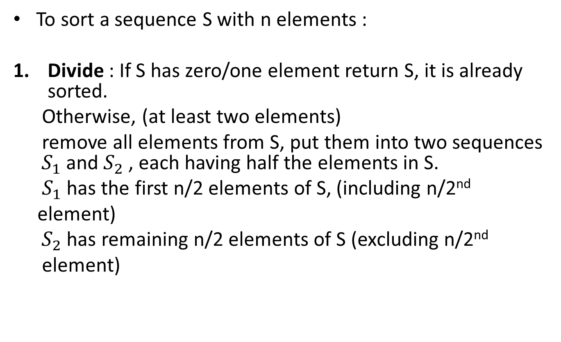
Using Divide and Conquer for sorting
To sort a sequence S with n elements :
Divide : If S has zero/one element return S, it is already sorted.
Otherwise, (at least two elements)
remove all elements from S, put them into two sequences ${ S}_{1}$ and $S_{2}$ , each having half the elements in S.
$S_{1}$ has the first n/2 elements of S, (including n/2nd
element)
${ S}_{2}$ has remaining n/2 elements of S (excluding n/2nd
element)

Slide 4



2. Recur : recursively sort sequences $S_{1}$ and $S_{2}$ .
3. Conquer : Put the elements back into S, by merging the sorted sequences $S_{1}$ and $S_{2}$ into a sorted sequence.
1. Divide in half
Split list equally
2. Recur
2. Recur
$$S_{1}$$
$$S_{2}$$
3. Merge

Slide 5
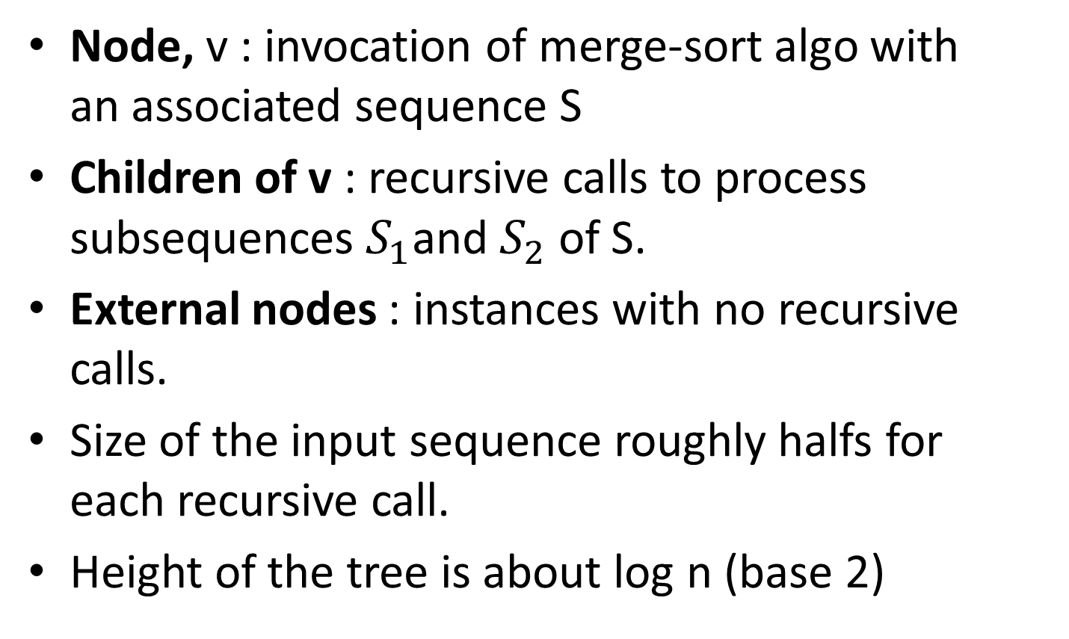
Merge – Sort Tree
Node, v : invocation of merge-sort algo with an associated sequence S
Children of v : recursive calls to process subsequences $S_{1}$and $S_{2}$ of S.
External nodes : instances with no recursive calls.
Size of the input sequence roughly halfs for each recursive call.
Height of the tree is about log n (base 2)

